Slide 1
IT4020 - Modern Topics in IT Assignment 2 Microservices Architecture
E-Learning Platform
Group Members:
• Neethila A.L.N. - Student Service
• Warunika R S - Course Service
• Karunarathne D T S - Enrollment Service
• Chathuranga D S I - Grade Service

Slide 2
Slide 2: Individual Contributions
Member | Role | Services | Contributions
Neethila A L N | Student Service Lead | Student Microservice | CRUD operations, Swagger docs
Warunika R S | Course Service Lead | Course Microservice | 9 endpoints, Swagger, testing
Karunarathne D T S | Enrollment Service Lead | Enrollment Microservice | Enrollment logic, relationships
Chathuranga D S I | Grade Service Lead | Grade Microservice | Grading system, calculations

Slide 3
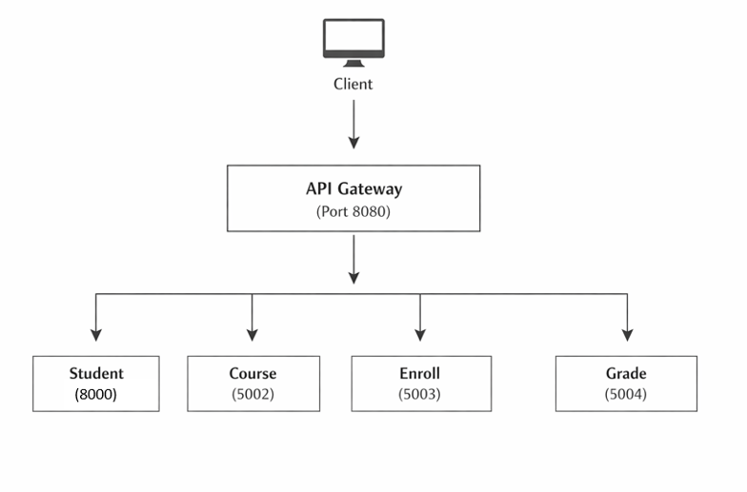
Architecture Overview

Slide 4
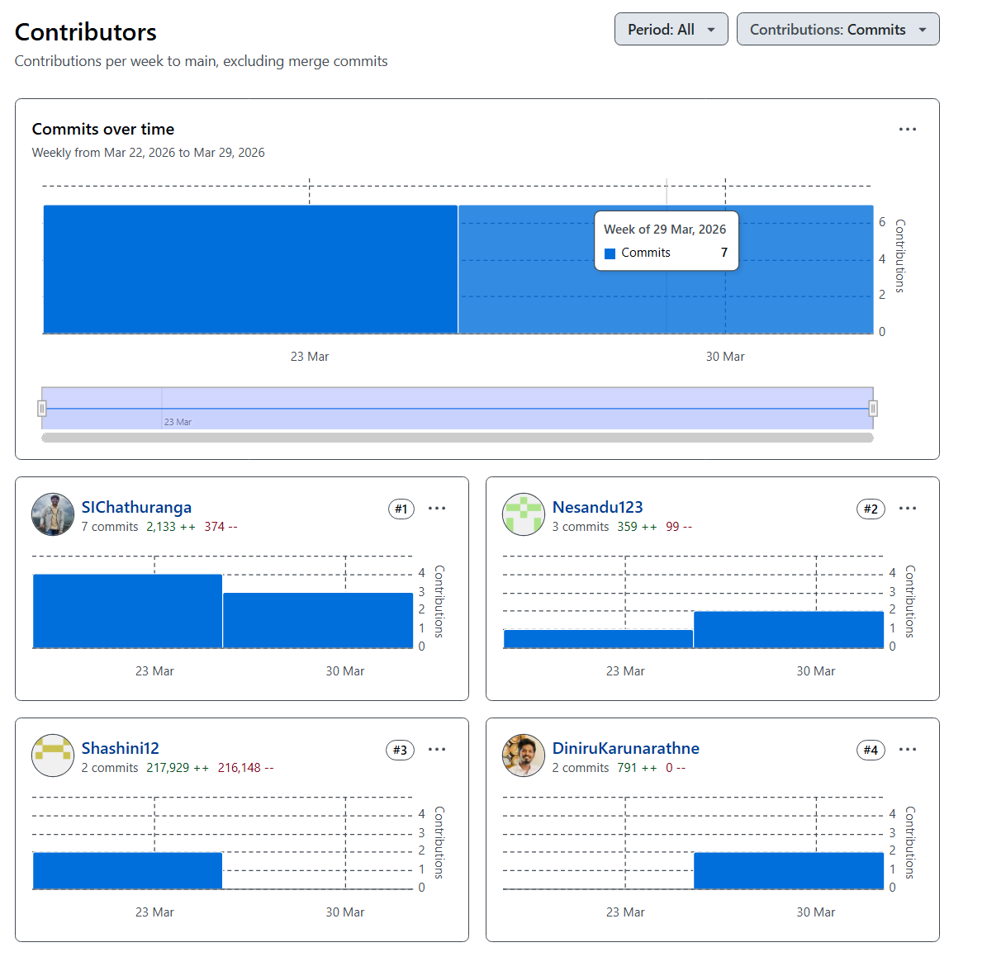
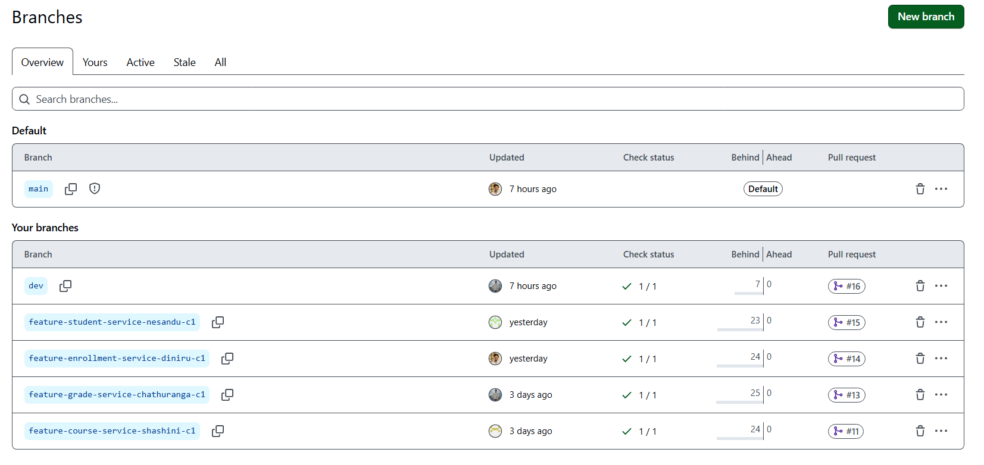
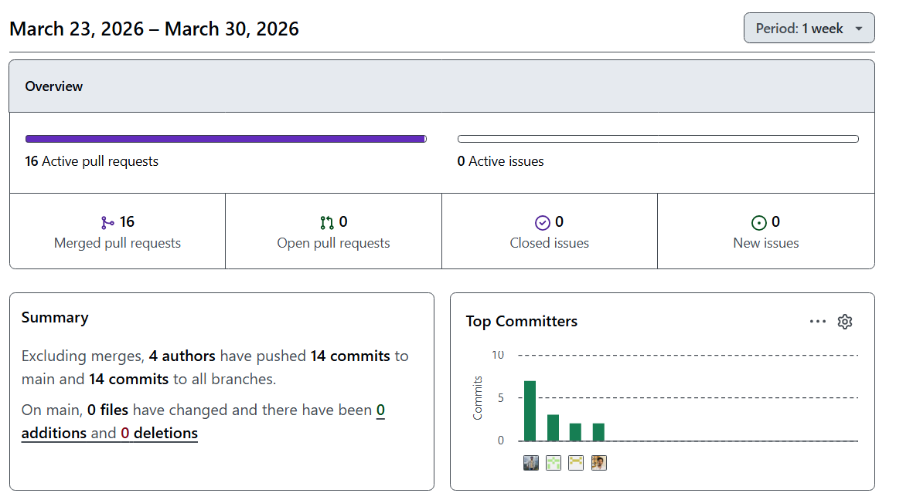
Version Control & Collaboration

Slide 5
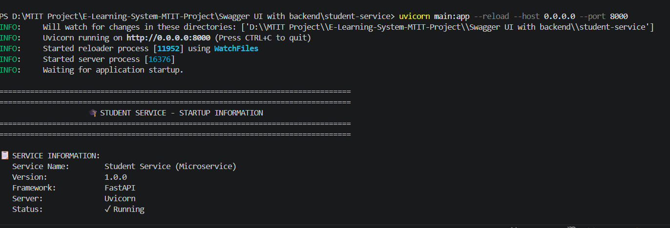
Student Service
Student Microservice
Port: 8000
Technology: Python + Flask
Purpose: Overall Students Management
Key Features:
• Create, Read, Update, Delete courses
• Search by instructor
• Check availability
• Generate statistics

Slide 6
API Endpoints
Method | Endpoint | Description
GET | /students | Retrieve all students
GET | /student/search | Search student by student name
POST | /students | Create a new student
GET | /students/by-course/{course} | Retrieve students according to the course name
GET | /students/courses | Get the list of unique courses.
GET | /students/course/{course}/count | Get count of students in a specific course
GET | /students/{student_id} | Get students according to their ID
PUT | /students/{student_id} | Update Students according to the student ID
DELETE | /students/{student_id} | Delete a student.

Slide 7
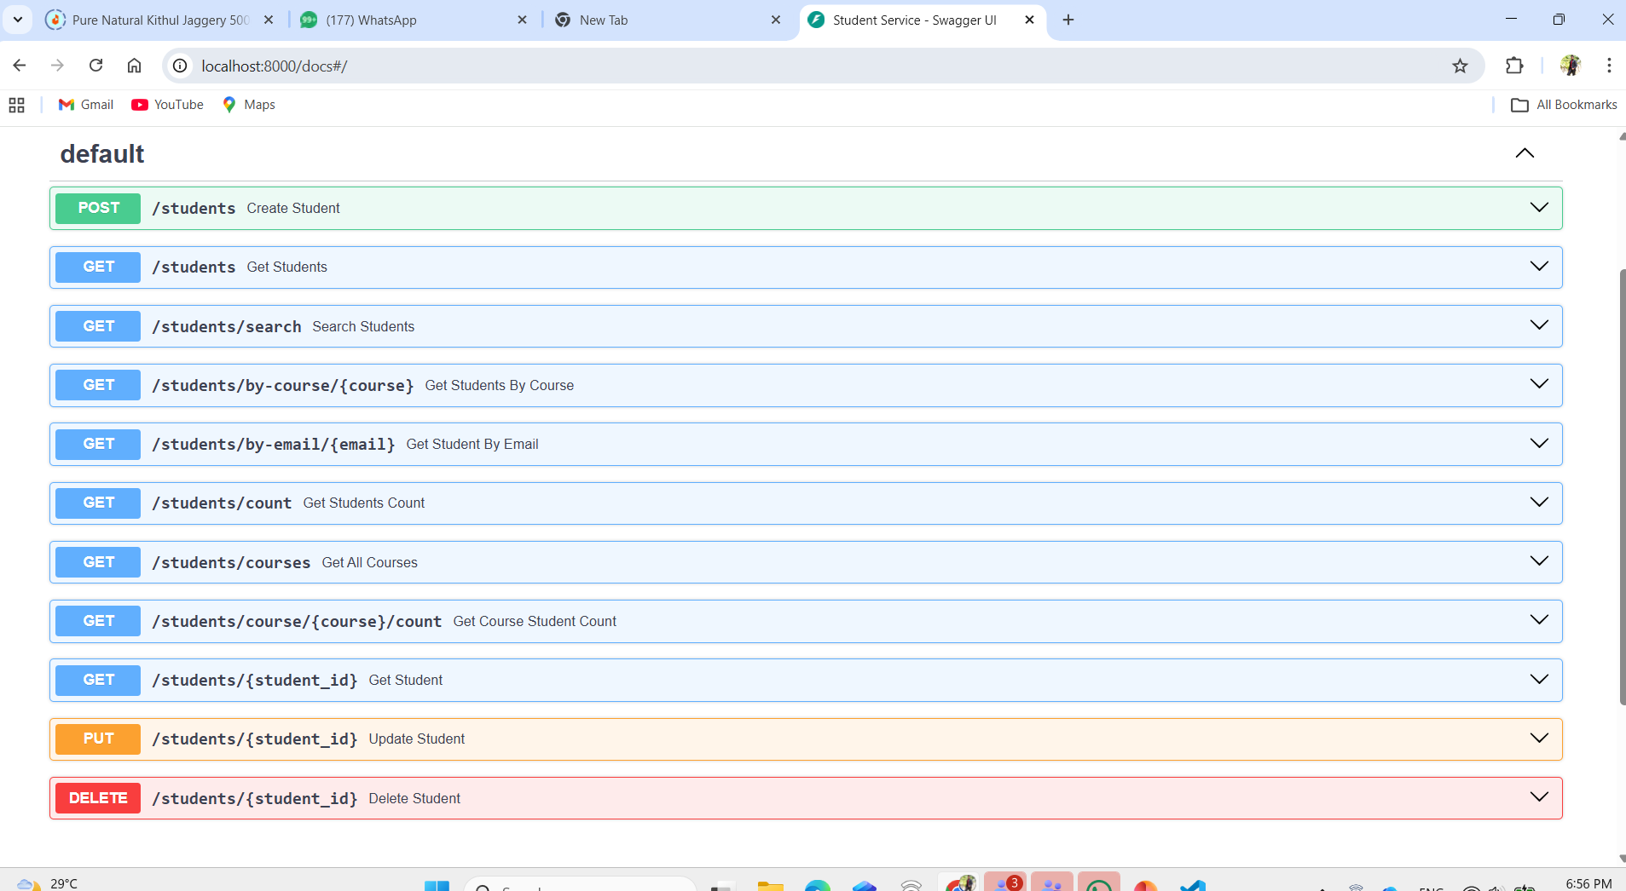
Direct Access Testing Swagger UI Direct Access

Slide 8
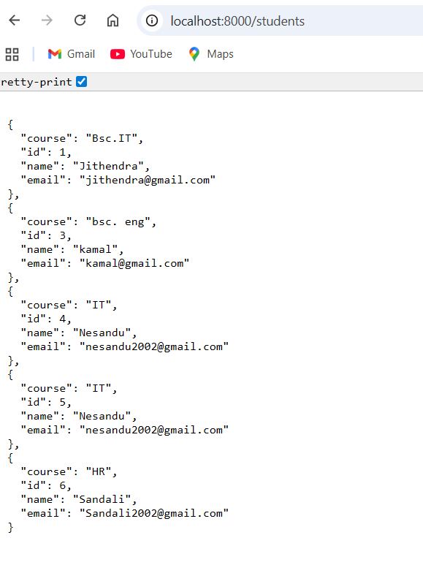
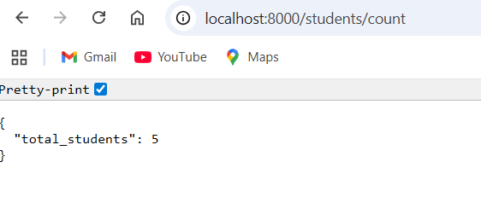
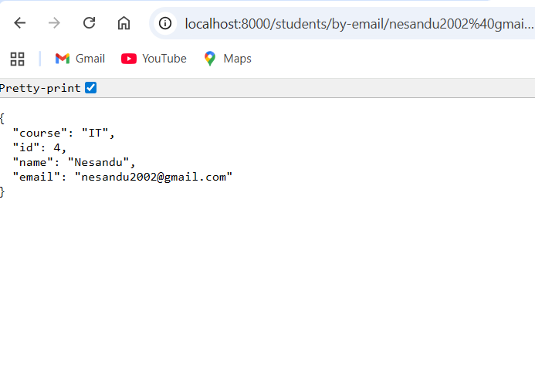
Get All Students Response
Get Statistics
Get Students by Email

Slide 9
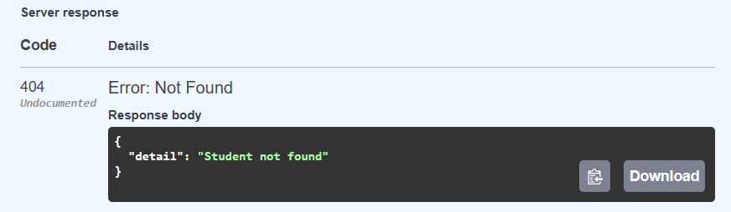
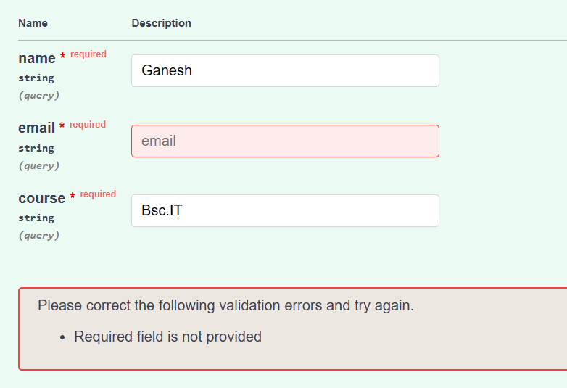
Error Handling
Student Not Found
Required Field Validation

Slide 10
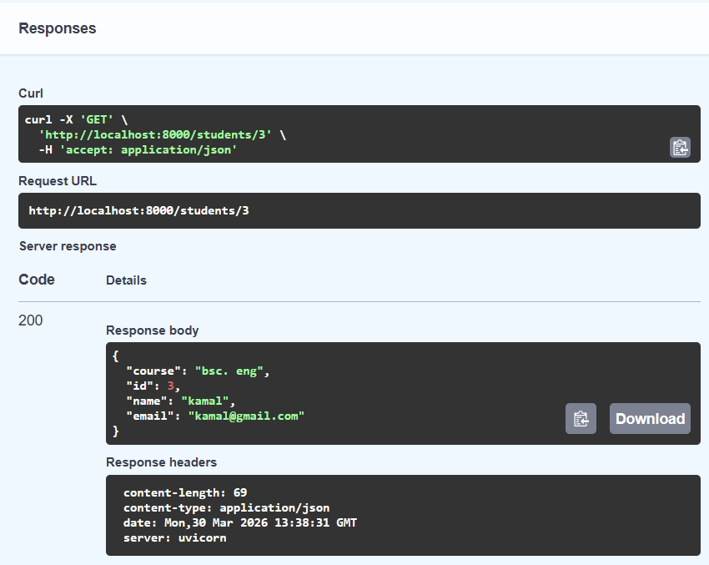
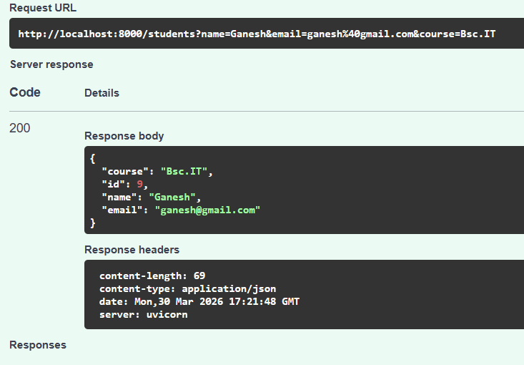
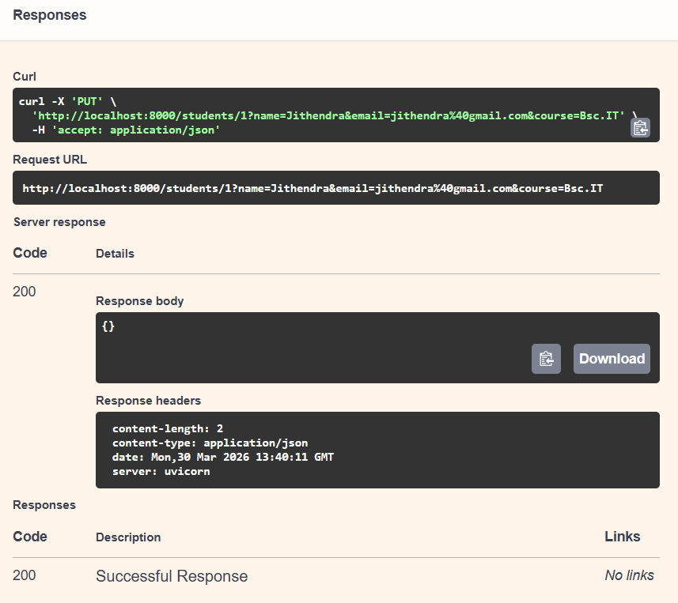
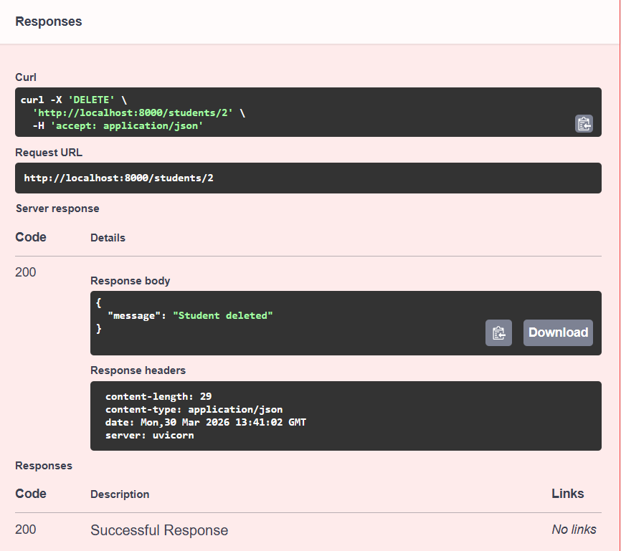
Crud Operations

Slide 11
Testing Summary
Test Case | Expected Result | Actual Result | Status
GET all students | 200 OK with students list | Works | PASS
GET by valid ID | 200 OK with student | Works | PASS
GET by invalid ID | 404 Not Found | Works | PASS
POST new student | 201 Created | Works | PASS
Get all courses | 200 OK with course list | Works | PASS
PUT update student | 200 OK updated | Works | PASS
Search by student name | 200 OK updated | Works | PASS
DELETE student | 200 OK deleted | Works | PASS
GET by email | 200 OK filtered list | Works | PASS
GET by course | 200 OK filtered list | Works | PASS
GET students count | 200 OK stats | Works | PASS

Slide 12
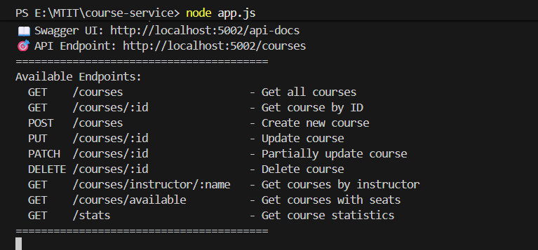
Course Service Slides
Course Microservice
Port: 5002
Technology: Node.js + Express
Purpose: Course catalog management
Key Features:
• Create, Read, Update, Delete courses
• Search by instructor
• Check availability
• Generate statistics

Slide 13
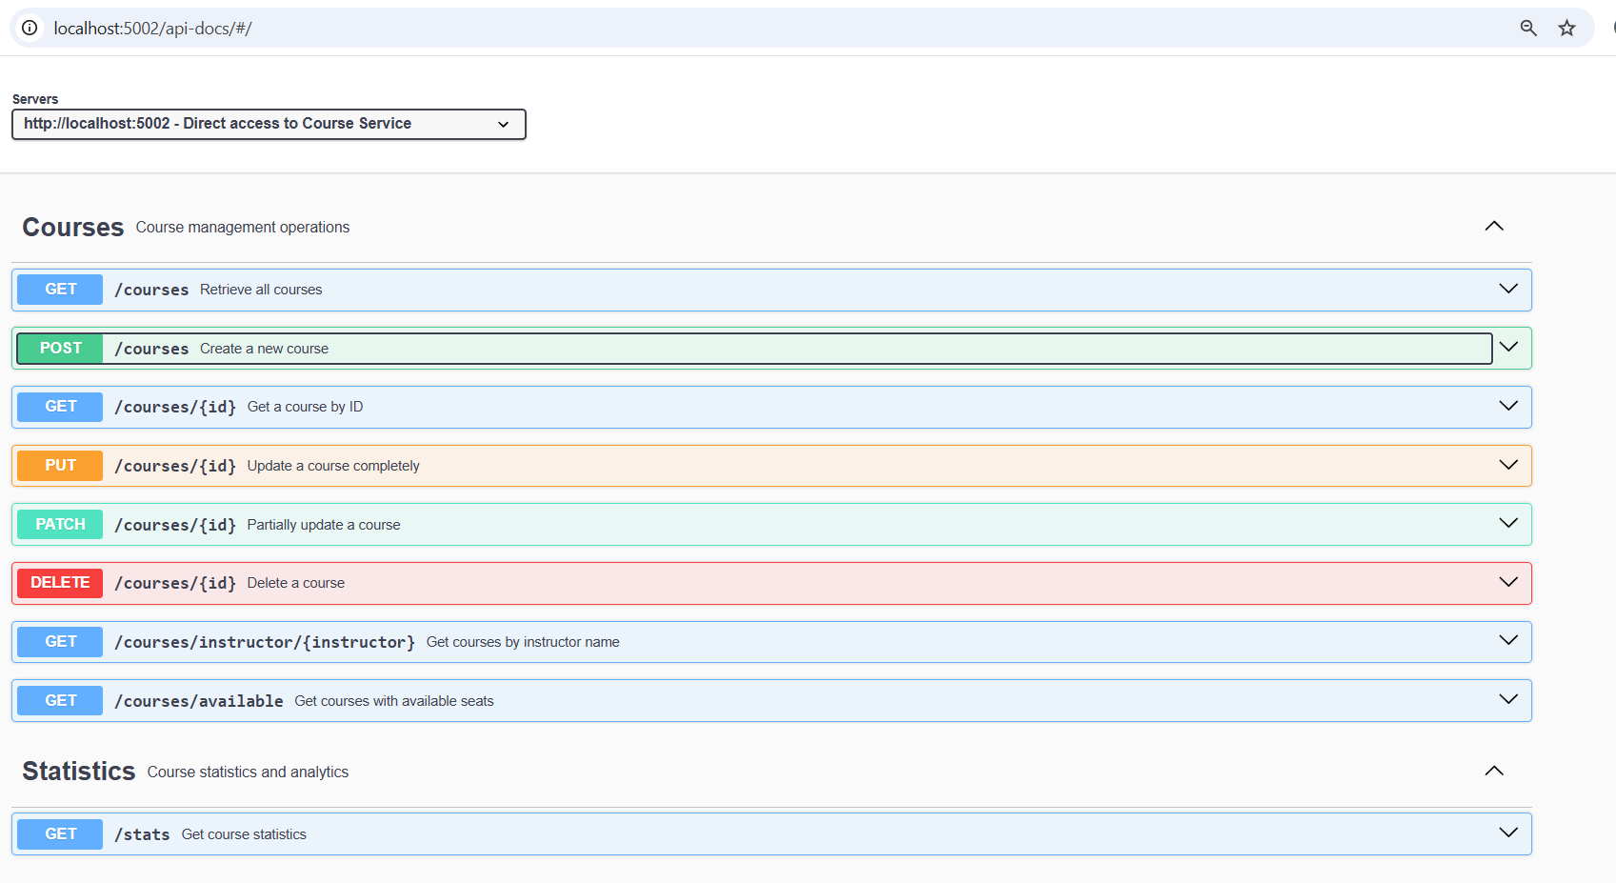
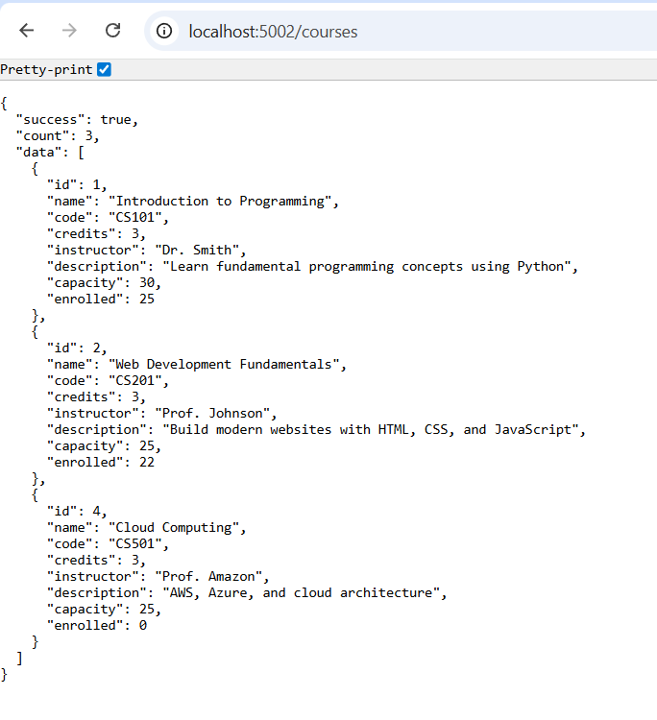
Direct Access Testing
Swagger UI Direct Access
GET All Courses Response

Slide 14
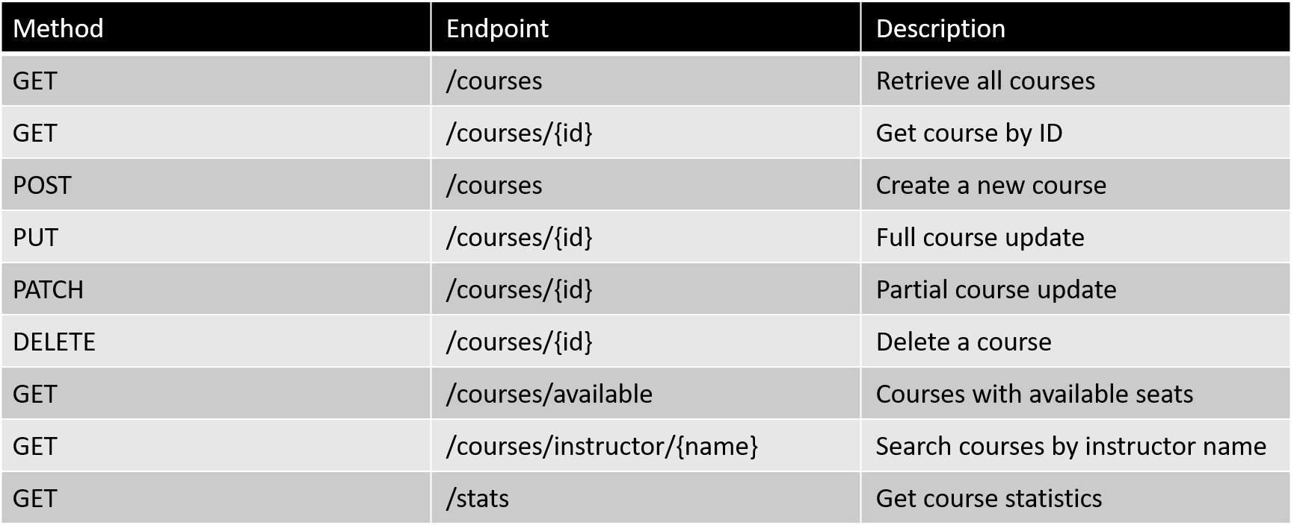
API Endpoints

Slide 15
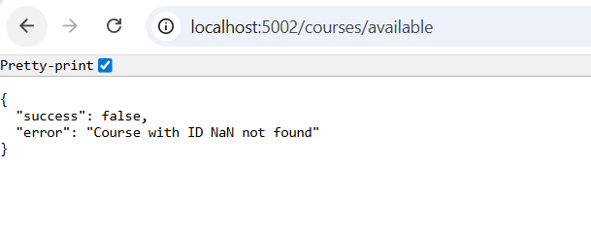
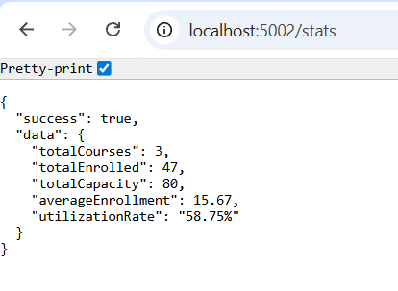
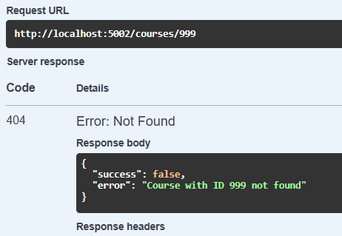
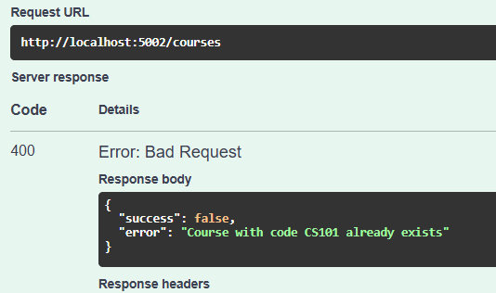
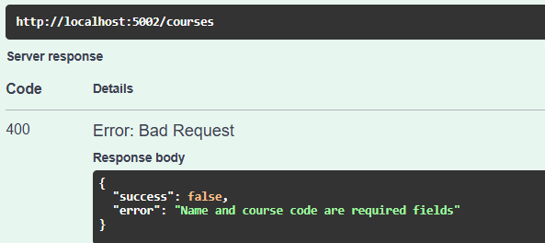
GET Available Courses
GET Statistics
Error Handling
Course Not Found (404)
Duplicate Course Code
Missing Required Fields

Slide 16
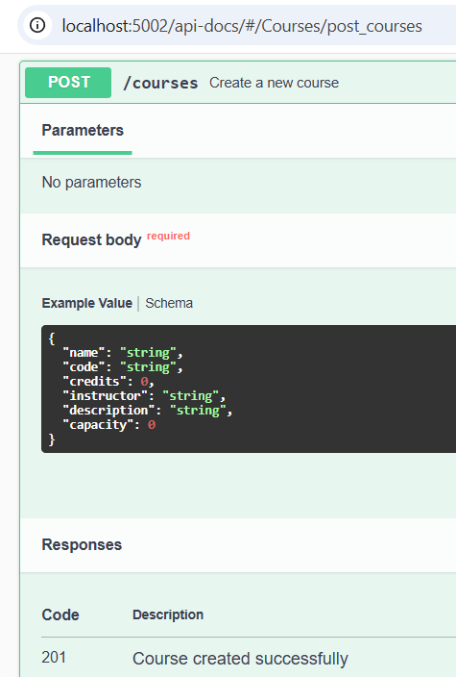
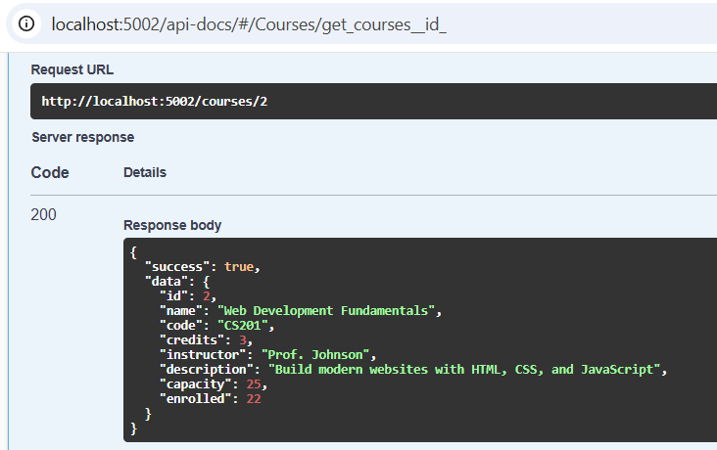
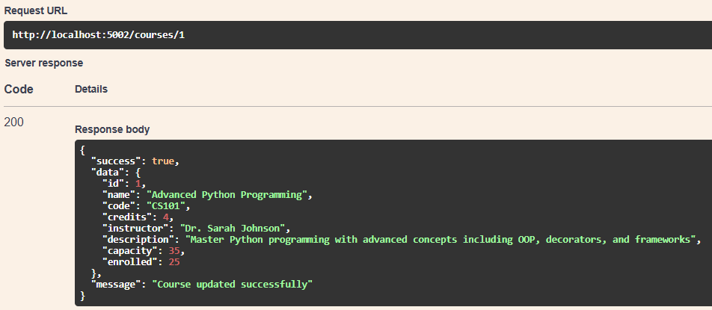
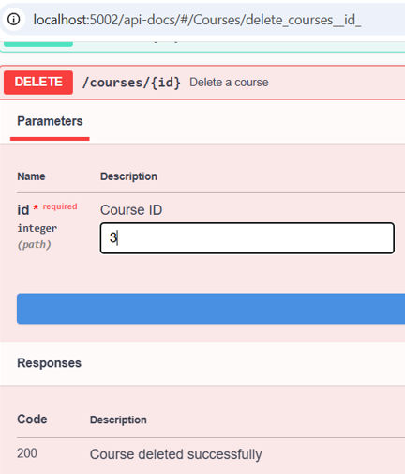
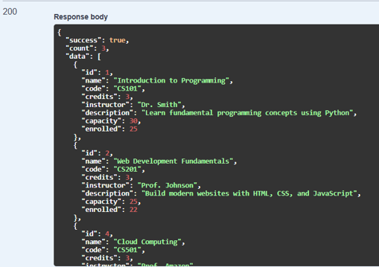
CRUD Operations
Create Course (POST)
Get Single Course (GET by ID)
Update Course (PUT)
Delete Course (DELETE)

Slide 17
Testing Summary
Test Case | Expected Result | Actual Result | Status
GET all courses | 200 OK with course list | Works | PASS
GET by valid ID | 200 OK with course | Works | PASS
GET by invalid ID | 404 Not Found | Works | PASS
POST new course | 201 Created | Works | PASS
POST duplicate code | 400 Bad Request | Works | PASS
PUT update course | 200 OK updated | Works | PASS
PATCH partial update | 200 OK updated | Works | PASS
DELETE course | 200 OK deleted | Works | PASS
GET available courses | 200 OK filtered list | Works | PASS
GET by instructor | 200 OK filtered list | Works | PASS
GET statistics | 200 OK stats | Works | PASS

Slide 18
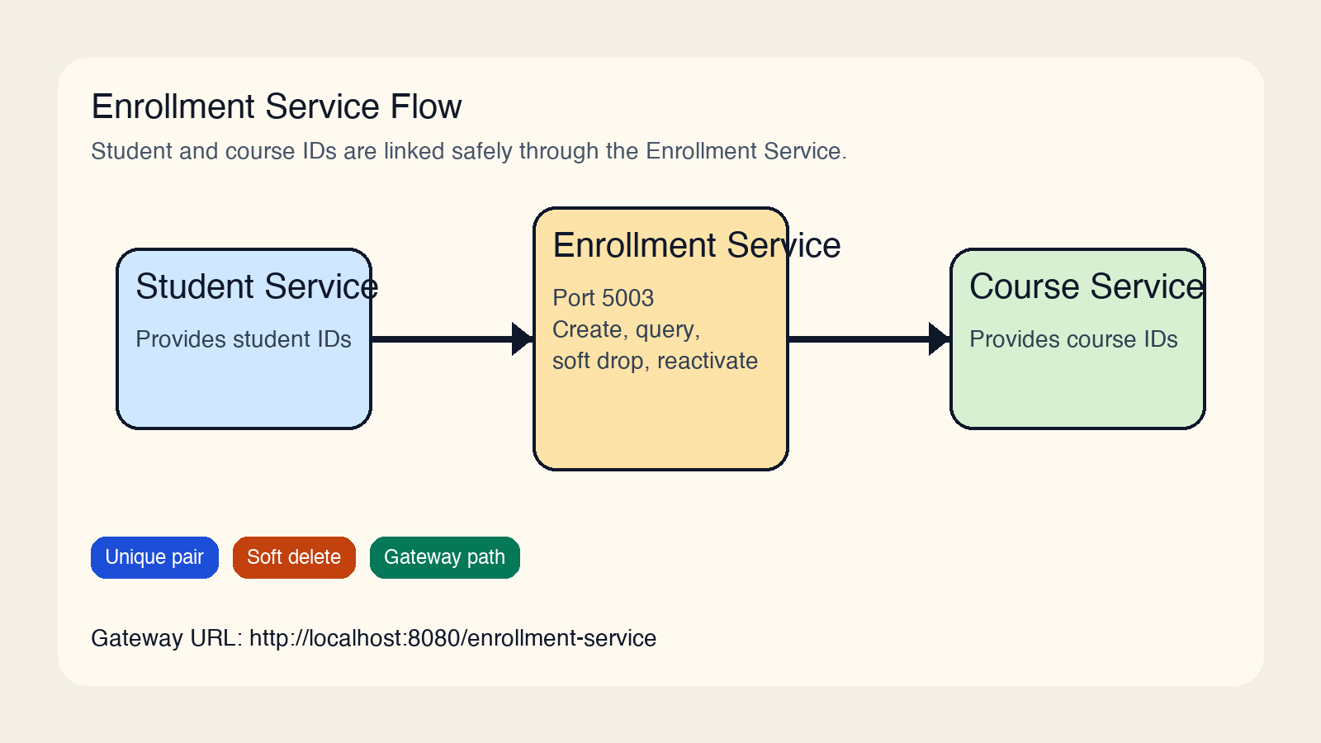
Enrollment Service
Enrollment Microservice
Port: 5003
Technology: Python + Flask
Purpose: Student-courseenrollmentmanagement
Key Features:
• Create, read, and reactivate enrollments
• View enrollments by student
• View students by course
• Soft drop and status updates

Slide 19
API Endpoints
Method | Endpoint | Description
GET | /health | Health check
GET | /enrollments | Retrieve all enrollments
GET | /enrollments/{id} | Get enrollment by ID
POST | /enrollments | Create or reactivate enrollment
PUT | /enrollments/{id} | Update status
DELETE | /enrollments/{id} | Soft drop enrollment
GET | /students/{studentId}/courses | List records by student
GET | /courses/{courseId}/students | List records by course
GET | /api-docs/ | Swagger UI

Slide 20
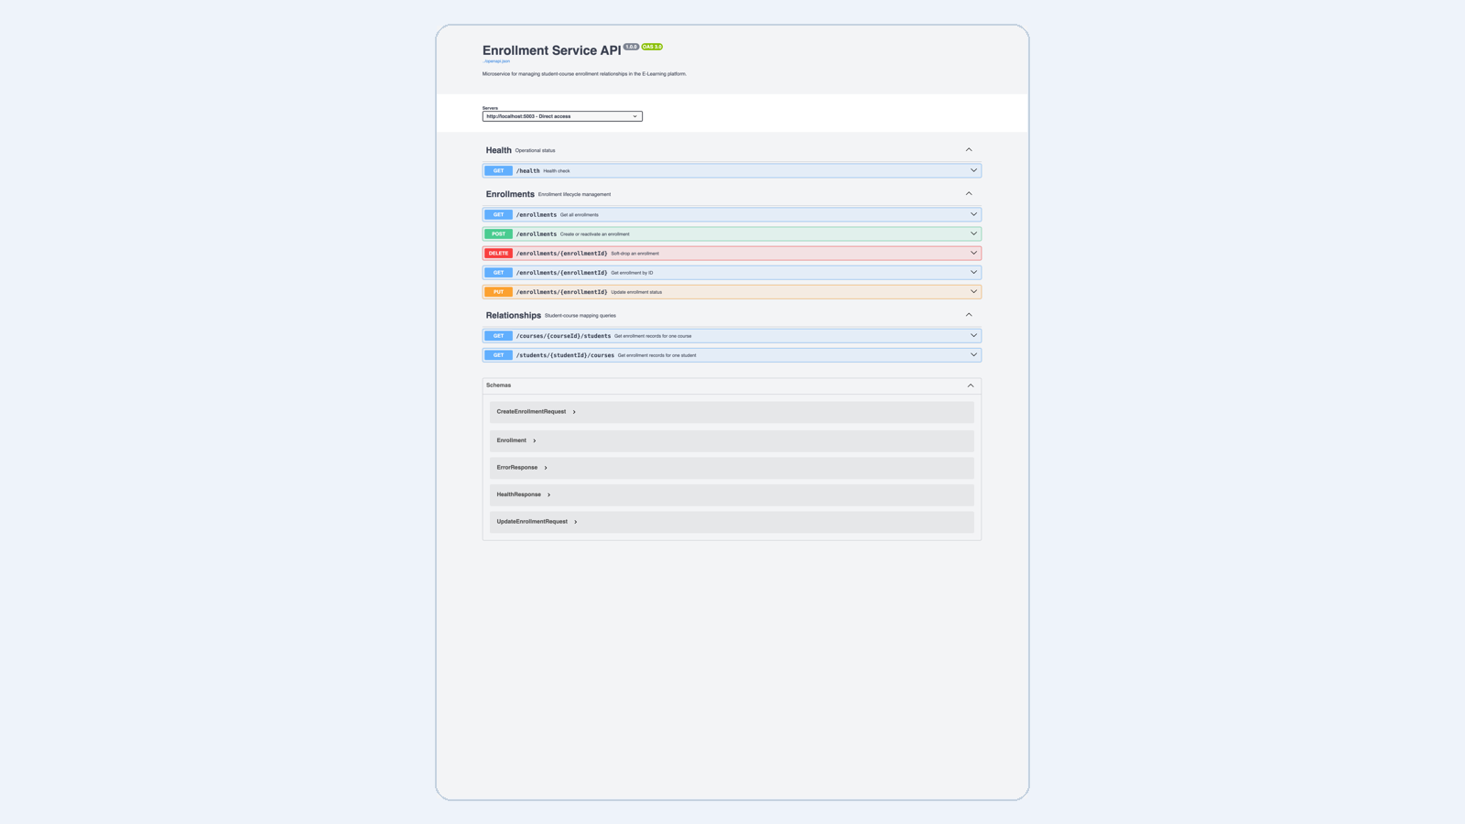
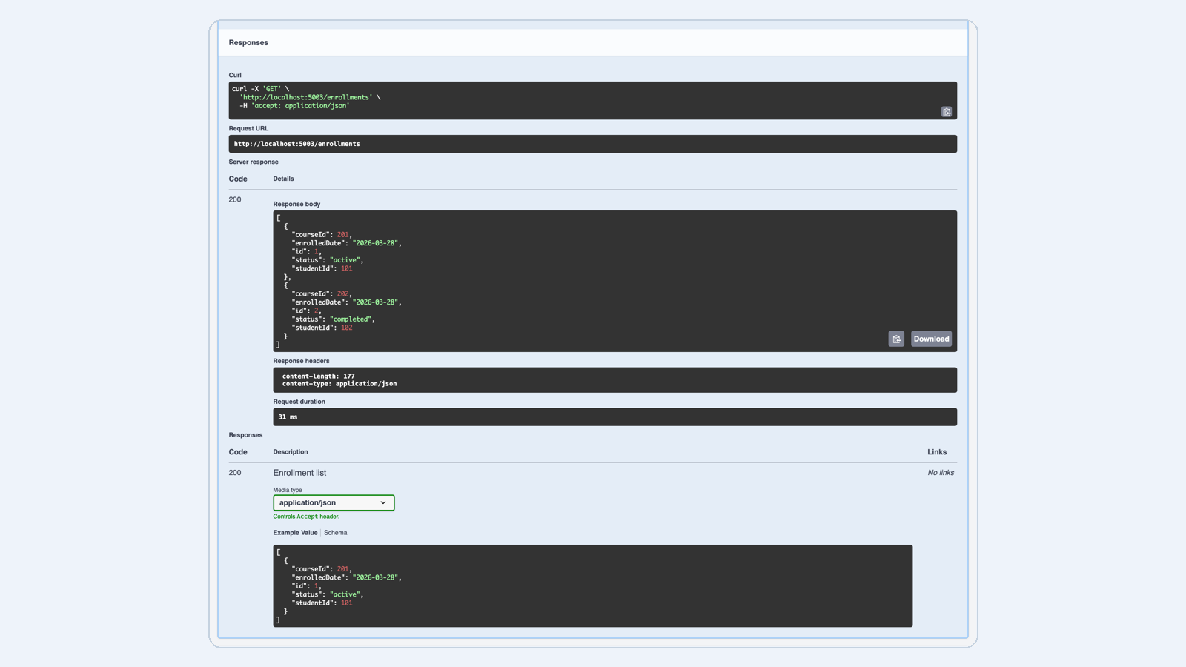
Direct Access Testing
Swagger UI Direct Access
GET Enrollments Response

Slide 21

Gateway Access Testing
Swagger UI via Gateway
GET Enrollments via Gateway

Slide 22
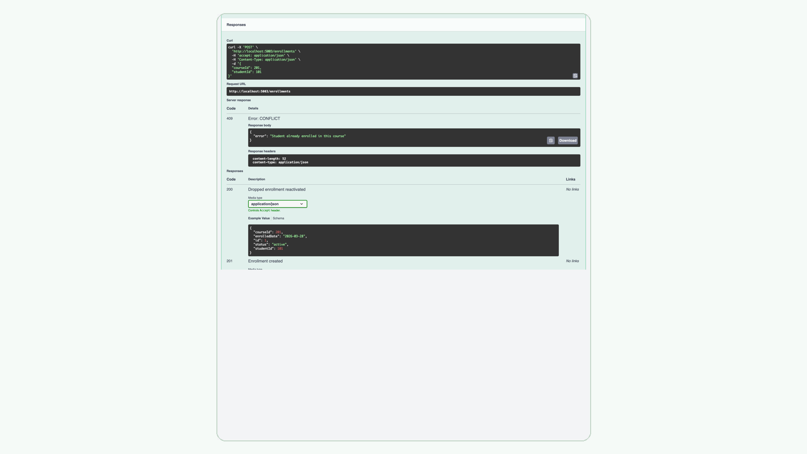
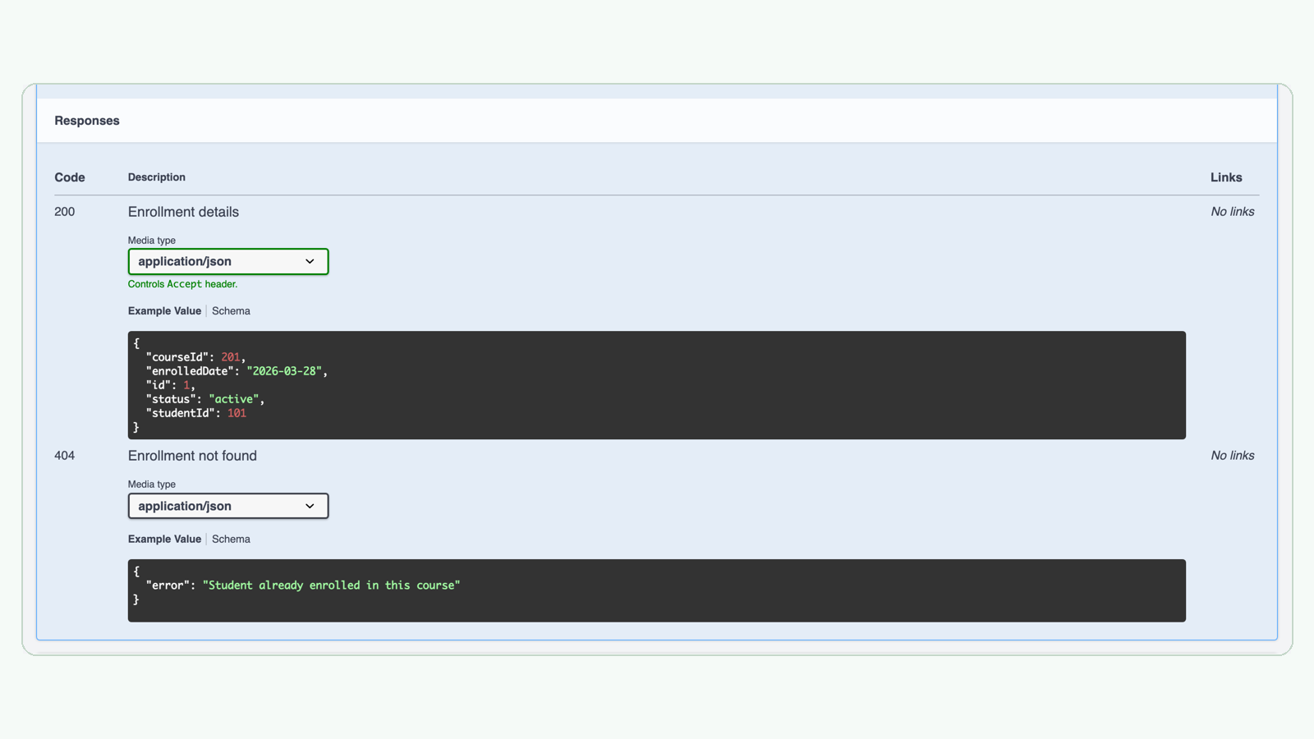
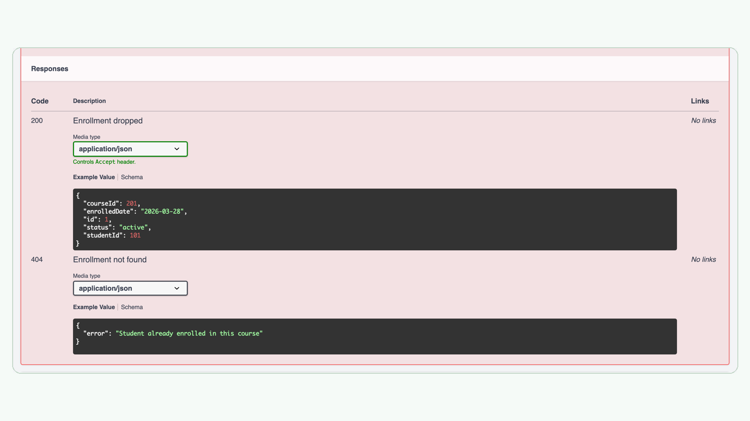
Duplicate Enrollment (409)
Missing Required Fields (400)
Validation and Relationship Logic
Enrollment Not Found (404)
Soft Drop via DELETE
Re-enroll Dropped Record

Slide 23
Testing Summary
Test Case | Expected Result | Actual Result | Status
GET all enrollments | 200 OK with enrollment list | Works | PASS
GET by valid ID | 200 OK with enrollment | Works | PASS
GET by invalid ID | 404 Not Found | Works | PASS
POST new enrollment | 201 Created | Works | PASS
POST duplicate enrollment | 409 Conflict | Works | PASS
PUT mark completed | 200 OK updated | Works | PASS
DELETE drop enrollment | 200 OK dropped | Works | PASS
POST re-enroll dropped | 200 OK reactivated | Works | PASS
GET student courses | 200 OK filtered list | Works | PASS
GET course students | 200 OK filtered list | Works | PASS
Gateway Swagger access | 200 OK docs visible | Works | PASS

Slide 24
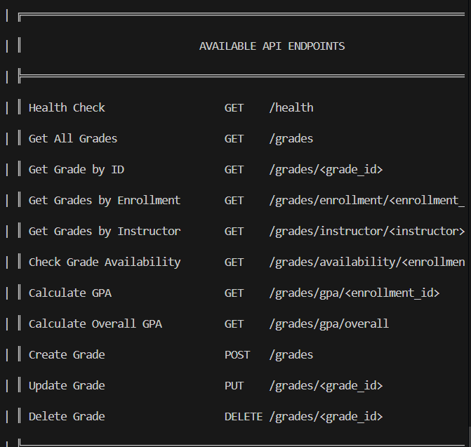
Grade Service Slides
Grade Microservice
Port: 5004
Technology: Python + flask
Purpose: Grade report management
Key Features:
• Create, Read, Update, Delete grades
• Search by instructor
• Check availability
• Generate GPA

Slide 25
API Endpoints
Method | Endpoint | Description
GET | /health | Health Check
GET | /grades | Get All Grades
GET | /grades/<grade_id> | Get Grade by ID
GET | /grades/enrollment/<enrollment_id> | Get Grades by Enrollment
GET | /grades/instructor/<instructor> | Get Grades by Instructor
GET | /grades/availability/<enrollment_id> | Check Grade Availability
GET | /grades/gpa/<enrollment_id> | Calculate GPA
GET | /grades/gpa/overall | Calculate Overall GPA
POST | /grades | Create Grade
PUT | /grades/<grade_id> | Update Grade
DELETE | /grades/<grade_id> | Delete Grade

Slide 26
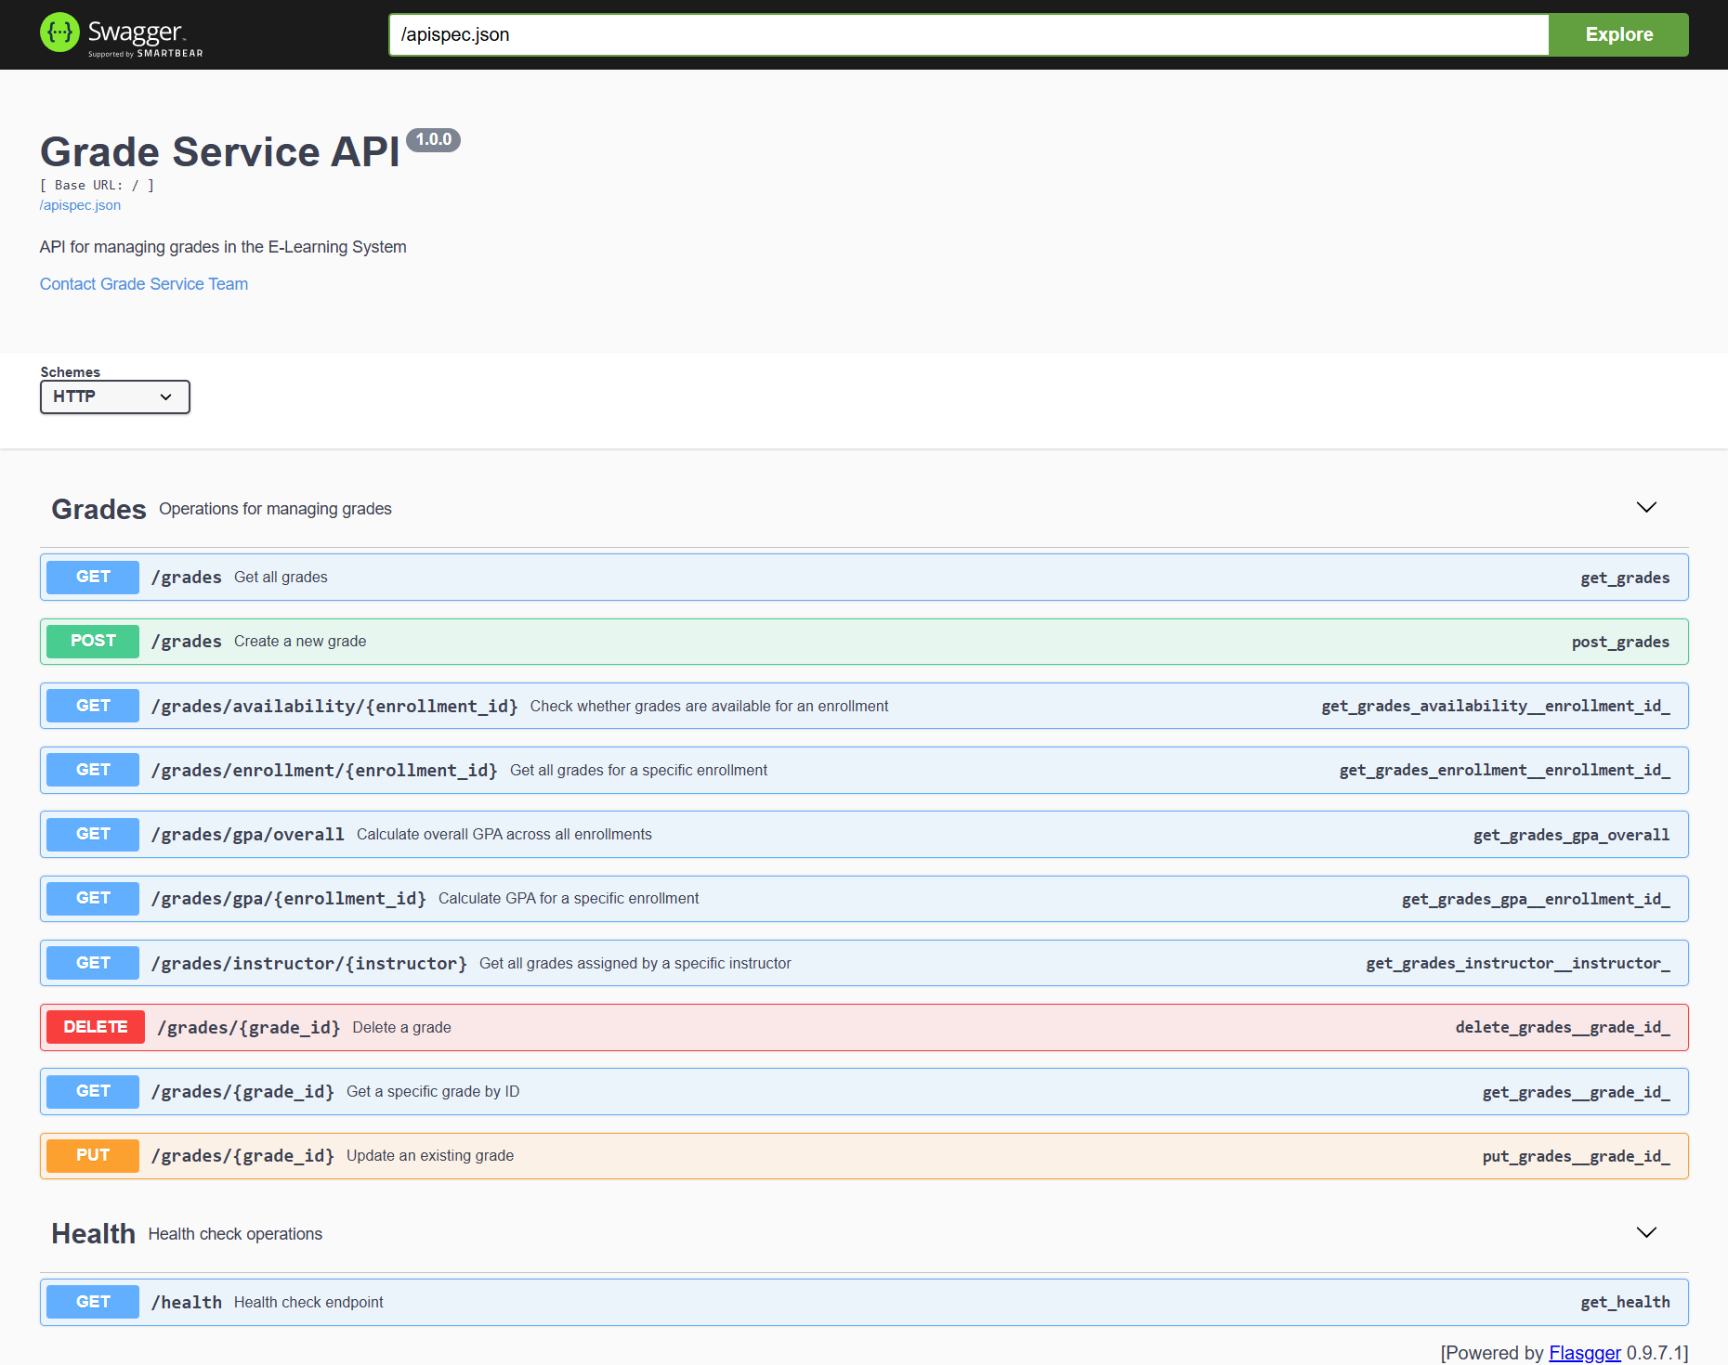
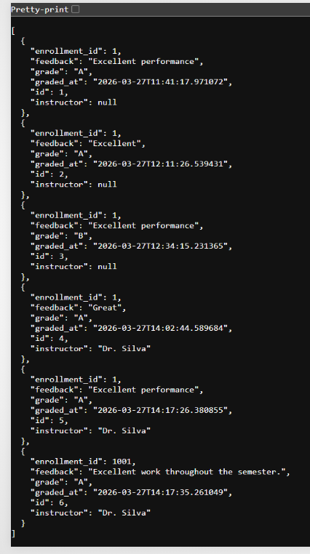
Direct Access Testing
Swagger UI Direct Access
GET All Courses Response

Slide 27
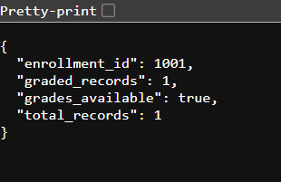
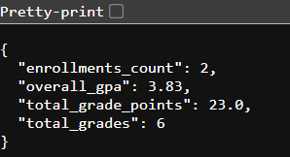
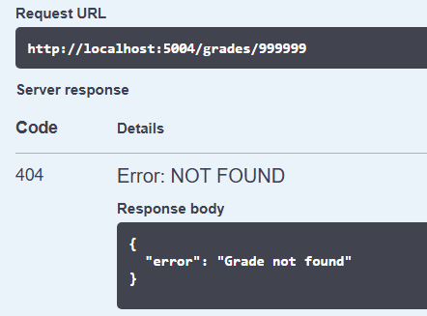
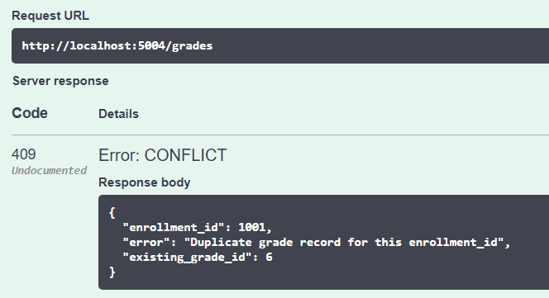
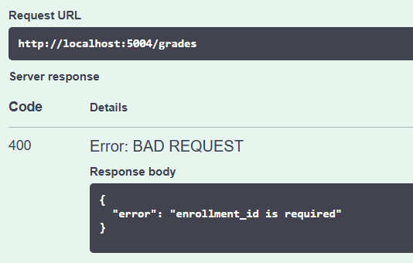
GET Available Grades
GET Overall GPA
Error Handling
Course Not Found (404)
Duplicate Grade Record
Missing Required Fields

Slide 28
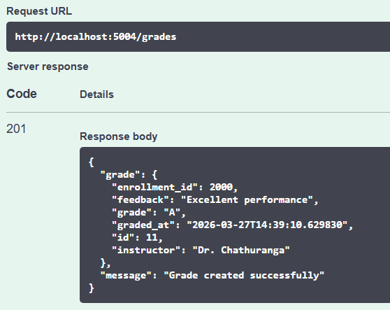
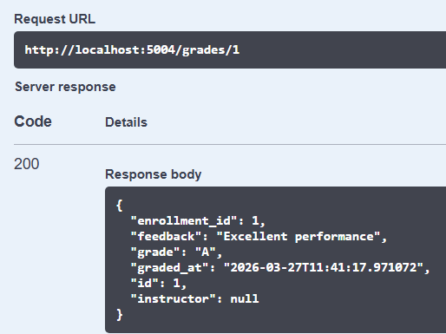
CRUD Operations
Create Grade (POST)
Get Single Grade (GET by ID)

Slide 29
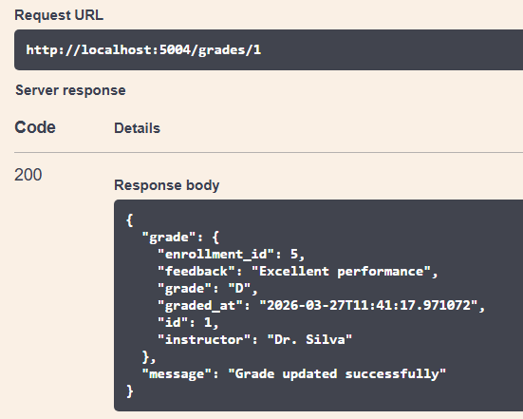
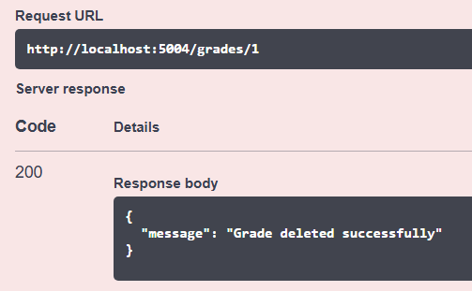
CRUD Operations
Update Grade (PUT)
Delete Grade (DELETE)

Slide 30
Testing Summary
Test Case | Expected Result | Actual Result | Status
GET all grades | 200 OK with grade list | Works | PASS
GET by valid ID | 200 OK with grade | Works | PASS
GET by invalid ID | 404 Not Found | Works | PASS
POST new grade | 201 Created | Works | PASS
POST duplicate enrollment | 409 Conflict | Works | PASS
POST missing required field | 400 Bad Request | Works | PASS
PUT update grade | 200 OK updated | Works | PASS
PUT duplicate enrollment | 409 Conflict | Works | PASS
DELETE grade | 200 OK deleted | Works | PASS
GET grade availability | 200 OK availability result | Works | PASS
GET by instructor | 200 OK | Works | PASS
GET GPA by enrollment | 200 OK | Works | PASS
GET overall GPA status | 200 OK | Works | PASS

Slide 31
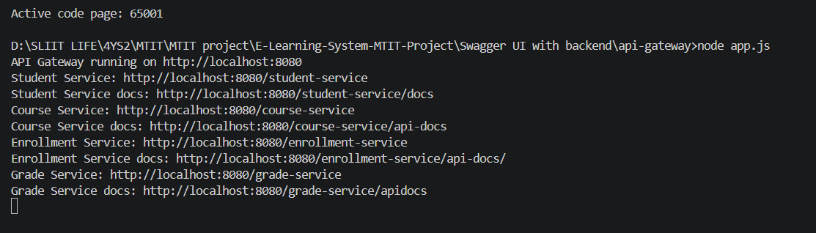
API - Gateway
Service | Port | Gateway Route | Direct Access | Gateway Access | Documentation
Student Service | 8000 | /student-service | http://localhost:8000 | http://localhost:8080/student-service | http://localhost:8080/student-service/docs
Course Service | 5002 | /course-service | http://localhost:5002 | http://localhost:8080/course-service | http://localhost:8080/course-service/api-docs
Enrollment Service | 5003 | /enrollment-service | http://localhost:5003 | http://localhost:8080/enrollment-service | http://localhost:8080/enrollment-service/api-docs/
Grade Service | 5004 | /grade-service | http://localhost:5004 | http://localhost:8080/grade-service | http://localhost:8080/grade-service/apidocs

